Slide 1
Advanced Encryption Standard Implementation on a Field Programmable Gate Array Development Board
By: CDT Matteo Cordray

Slide 2
Agenda
Overview
System Design
AES
UART
Current Progress
What’s Next

Slide 3
Overview
Why this project?
Why on an FPGA?
Why AES?

Slide 4
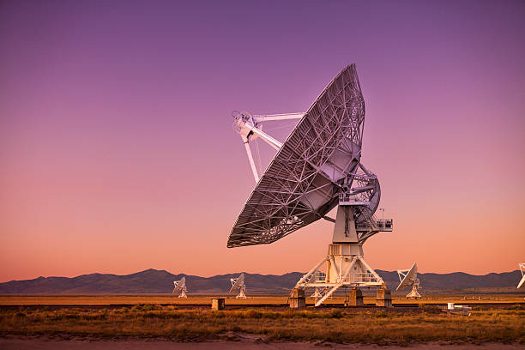


Overview – Why this project?
First learned about AES during CY450 class…
Ultimately: Modern computers need secure hardware
Communication Systems
Data Storage Centers
Transportation

Slide 5
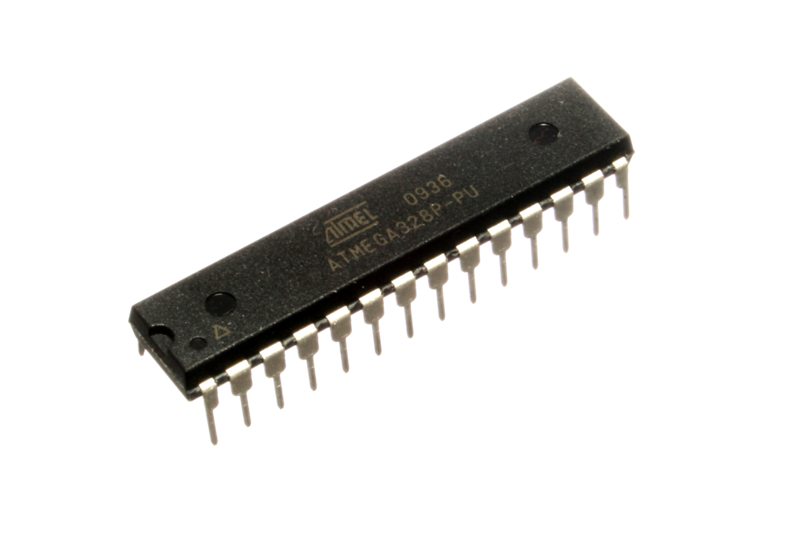
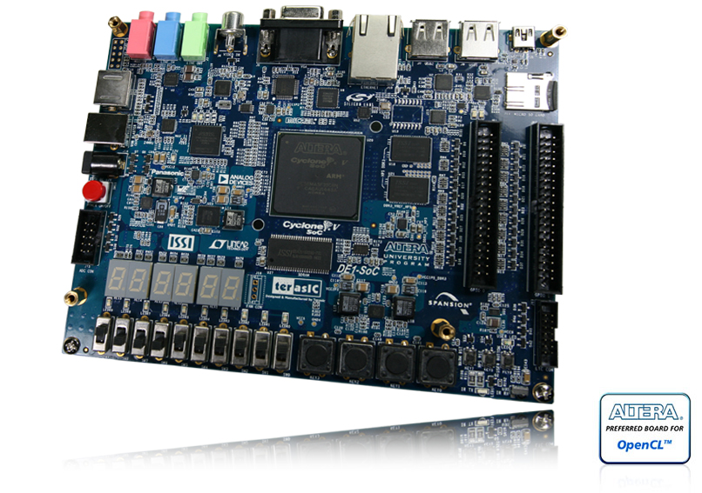
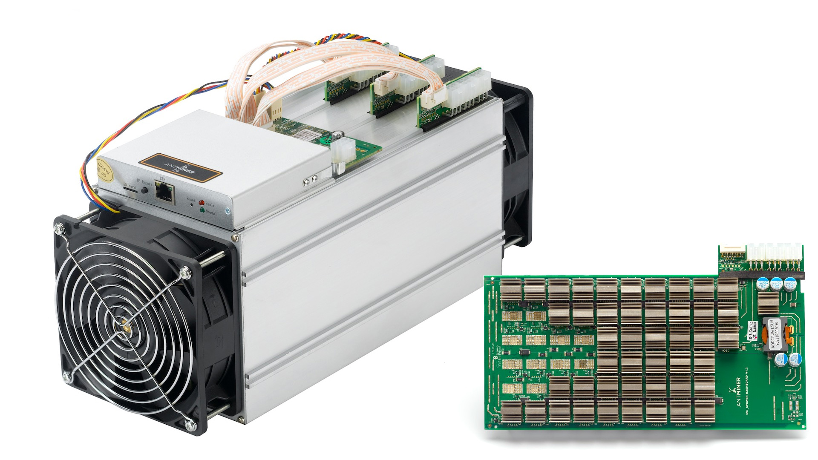
Overview – Why on an FPGA?
Type | Cost | Efficiency / Speed | Flexibility
Microcontroller | <$5 p.u. | Can run semi-concurrent tasks (FreeRTOS). Efficient, but not as fast as an average FPGA (20 MHz). | Easy to purchase individual chip, can connect any peripheral you’d like. However, easier to stick with common protocols.
FPGA | ~$100-$1k p.u. | Only one task – efficient and fast hardware. (550 MHz max). | Typically stick to what’s on development board. But overall can change whatever you want.
ASIC | $100k - $1m p.u. | Only one task – very efficient and fast hardware. | Configuration cannot change.
FPGAs provide the most flexibility, with tradeoffs in cost and efficiency.

Slide 6
Overview – The De1-SOC Board
Used development board’s soft processor during Computer Architecture course (EE375).
Benefits
Easy to program through Intel Quartus Software.
Easy to obtain through EECS department.
Drawbacks
Documentation lacks explanations, and example code is hard to find compared to newer FPGA’s on the market.
Half of the space is taken up by a soft-core processor, which makes the general size of the development board quite large.

Slide 7
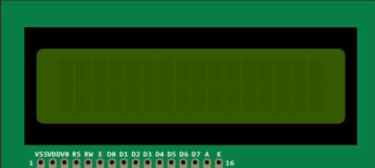
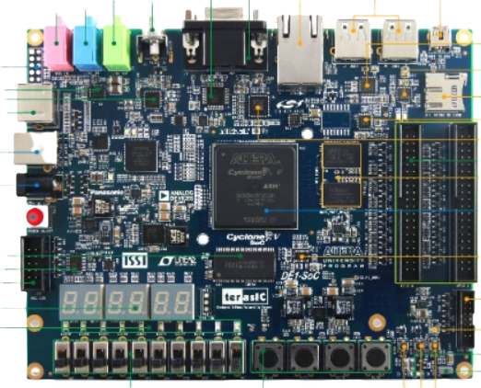
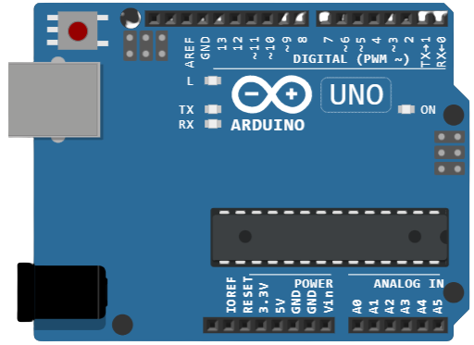
System Design - Encryption
Goal for the design is to showcase a simple, yet effective demonstration of the successful operation of AES on a single FPGA.
Encryption
Hello, World!
dQEPBnxXBxzosDldimjK1w==

Slide 8
System Design - Decryption
Goal for the design is to showcase a simple, yet effective demonstration of the successful operation of AES on a single FPGA.
Decryption
dQEPBnxXBxzosDldimjK1w==
Hello, World!

Slide 9

System Design - Connections
Connections - Encryption
Hello, World!
Serial Connection
USB-Serial Cable

Slide 10
System Design - Connections
Connections - Encryption
Hello, World!
dQEPBnxXBxzosDldimjK1w==
Serial Connection
Serial Connection
UART (TX, RX)
Pin 0, 1 on Arduino
GPIO Pin 25, 26 on FPGA

Slide 11
System Design - Connections
Connections - Decryption
dQEPBnxXBxzosDldimjK1w==
Hello, World!
Serial Connection
Serial Connection
UART (TX, RX)
Pin 0, 1 on Arduino
GPIO Pin 27, 28 on FPGA

Slide 12
System Design - Connections
Connections – Whole System
Encryption
dQEPBnxXBxzosDldimjK1w==
Decryption
Hello, World!
Hello, World!

Slide 13
AES – Advanced Encryption Standard
Why AES?
What is AES?
The Advanced Encryption Standard was one of the most successful implementation taught in CY450.
The CY450 class is where project idea originated.
Benefits
AES lets you choose key sizes, whereas others such as DES have a fixed key length (56-bit key).
Negatives
Security is still dependent on key size.

Slide 14
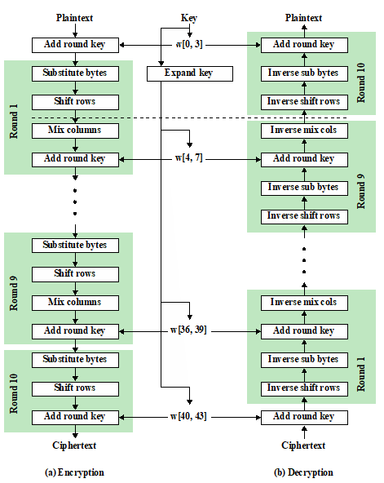
AES – How it Works
Substitute Bytes
Uses a table (S-Box) to perform byte-by-byte substitutions
Shift Rows
Permutation by row
Mix Columns
A substitution that alters each byte in a column as a function of all the bytes in the column
Add Round Key
Bitwise XOR of the current block with a portion of the expanded key
*Slide taken from CY450 – Lesson 17 –Cryptography I ppt

Slide 15
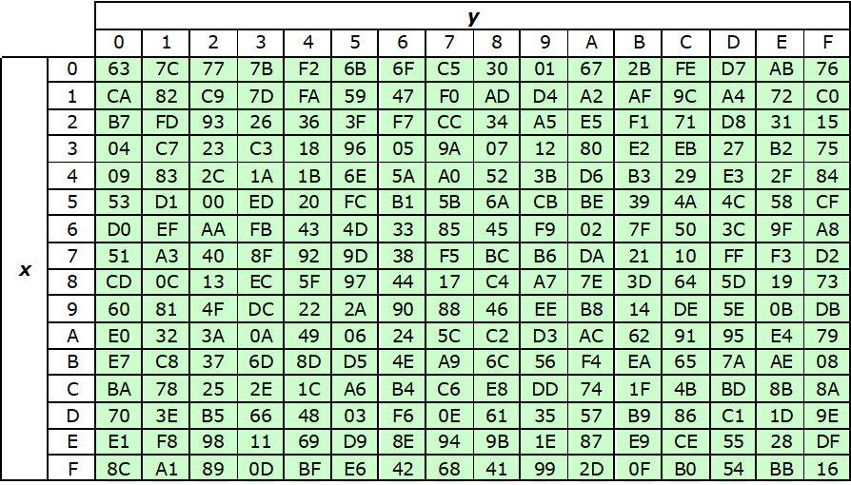
AES – How it Works
AES S-Box
If my input is 0x95..
Then my output is 0x2A
*Slide taken from CY450 – Lesson 17 –Cryptography I ppt

Slide 16
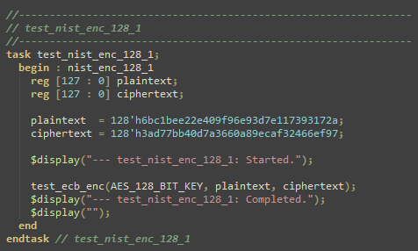
AES – Test Bench Code
Compare output of AES from plaintext to ciphertext
*Slide taken from CY450 – Lesson 17 –Cryptography I ppt

Slide 17
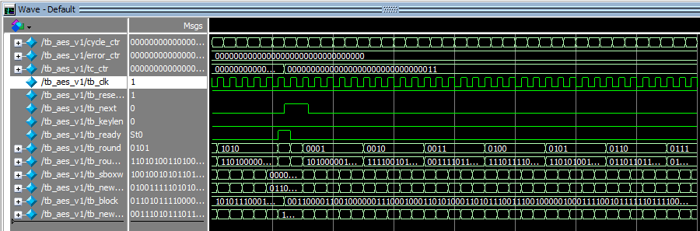
AES – Test Bench Simulation
Clock Cycle
Add Round Key
S-Box
Block (shift, etc)
*Slide taken from CY450 – Lesson 17 –Cryptography I ppt

Slide 18
UART – Universal Asychronous/Synchronous Transmitter
Why UART?
What is UART?
The UART Protocol is a Protocol designed to serially communicate between two clients using only two wires
Other implementations include RS-232, SWD, etc.
Benefits
Easy to interface with Arduino IDE and the Arduino Framework using an Arduino Uno.
Asynchronous mode does not require a clock line.
Negatives
Communication is slower than SPI, or other high-speed protocols.

Slide 19
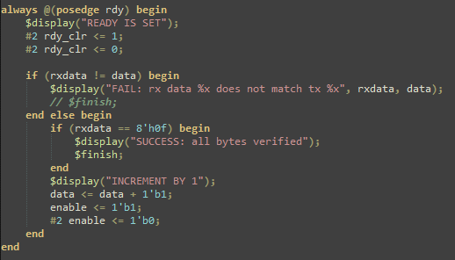
UART – Testbench Code
Sends a bit through the transmit line and verifies the bit is received on the receive line.
Simple to test in testbench.

Slide 20
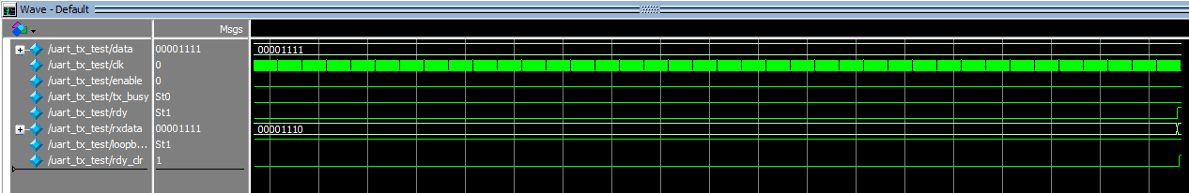
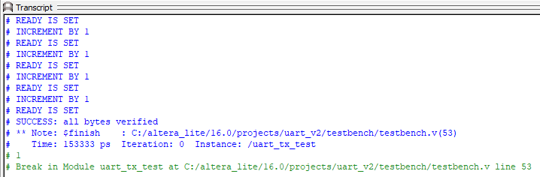
UART – Testbench Simulation
Clock for testbench, not UART
These results match, so we get a success message
Takes around 150 ns to finish job…something to consider

Slide 21
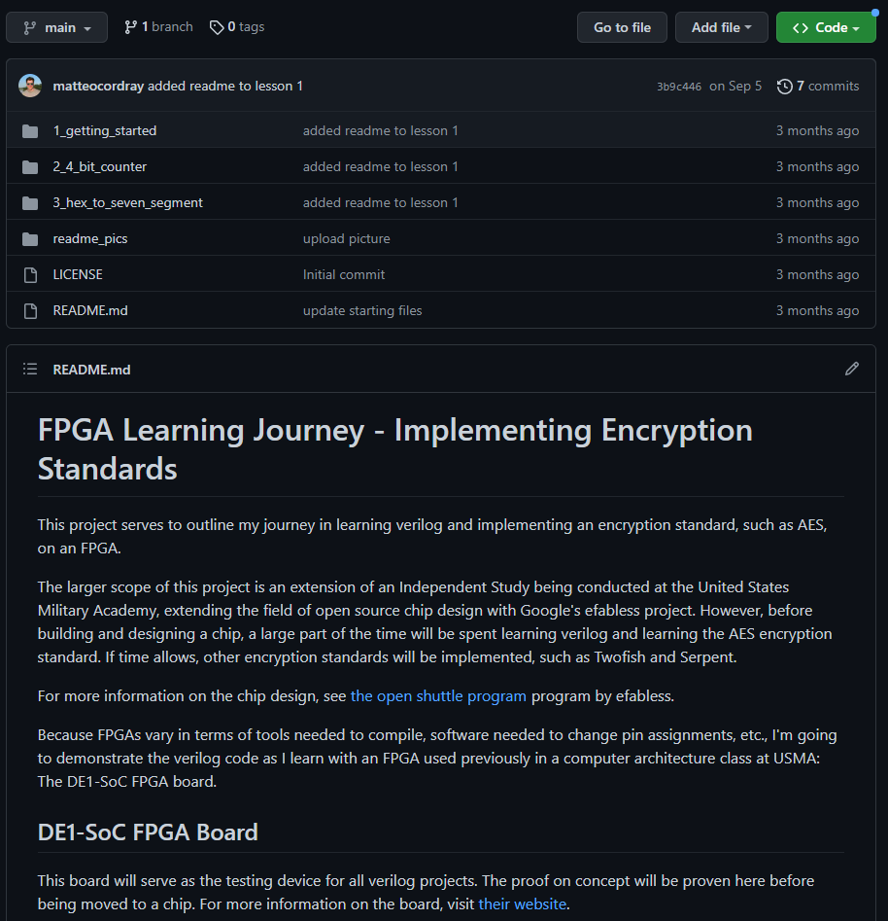

Current Progress
Not fully up to date, but Github website contains code on a public repository documenting my journey learning Verilog.
Point to resources used throughout the project.
For future -> Add current UART + AES code and links to sources on Github.

Slide 22
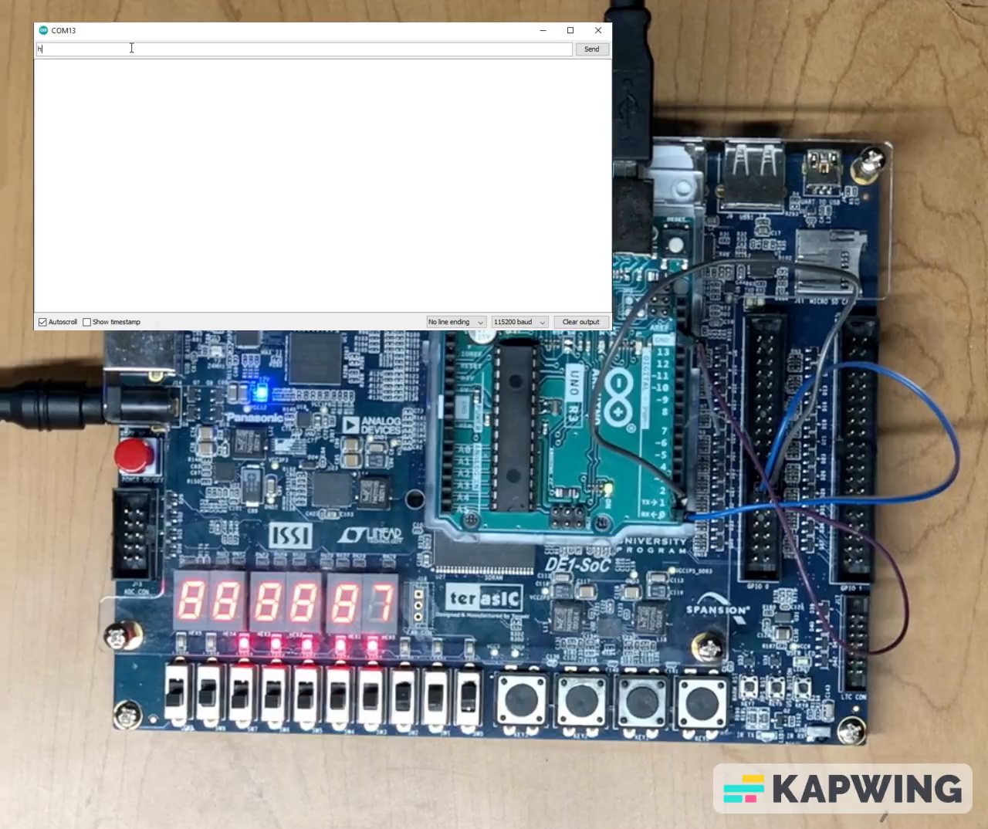
Current Progress - UART

Slide 23
What’s next?
Long range goal: Complete full implementation to send to eFabless Caravel Project.
Short range goal: Prove system works on FPGA with Arduino’s to display output.
Integrate UART and AES capability with two Arduino’s for encryption.
Integrate UART and AES capability with two Arduino’s for decryption.
Combine encryption and decryption parts together.
Connect three Arduino’s to prove system works.

Slide 24


AES and UART code respositories
AES: secworks/aes: Verilog implementation of the symmetric block cipher AES (Advanced Encryption Standard) as specified in NIST FIPS 197. This implementation supports 128 and 256 bit keys. (github.com)
UART: varmil/uart-verilog: the UART module with Quartus Prime (github.com).

Slide 25
Questions?

